Slide 1


Ligands of coordination compounds
Al-Farabi Kazakh National University
Faculty of Chemistry and Chemical technology
Department of General and Inorganic Chemistry
PhD Bakhadur Askar

Slide 2


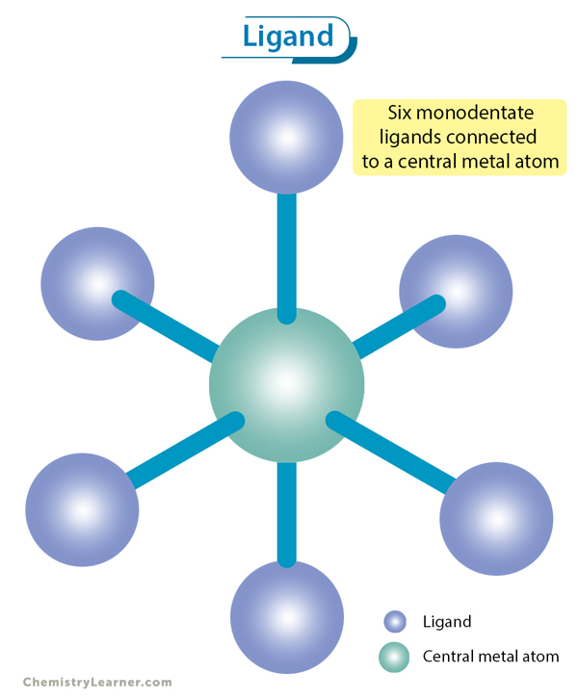


Ligands
In coordination chemistry, a ligand is any atom, ion, or molecule that donates one or more pairs of electrons to a central metal atom or ion to form a coordination bond.
Ligands act as Lewis bases, donating electron pairs.
The metal center acts as a Lewis acid, accepting electron pairs.
The number of ligand donor atoms bonded to the metal defines the coordination number of the complex.
Example:
In the complex $\left[Co\left(NH_{3}{\left.)\right.}_{6}{\left.]\right.}^{3+}\right.\right.$, six ammonia molecules act as ligands, each donating a lone pair of electrons from nitrogen to the cobalt ion.

Slide 3
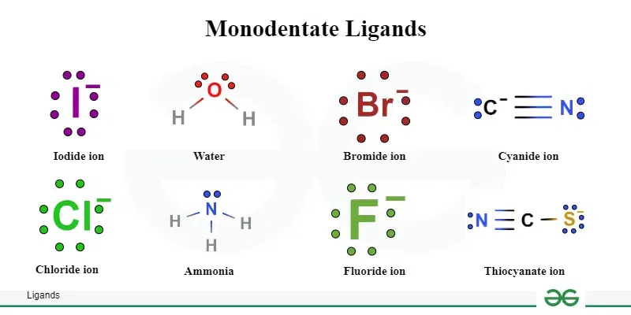
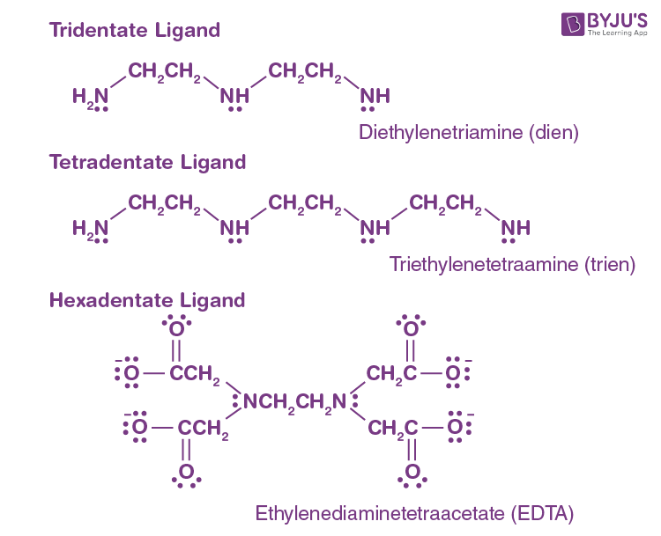
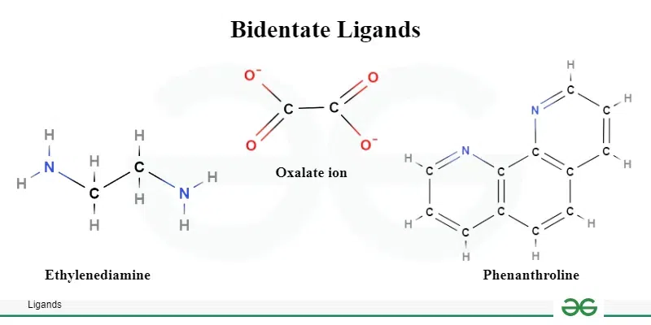
Types of ligands according to denticity
Denticity refers to the number of donor atoms within a ligand that can bind to a metal center.
Monodentate ligands possess a single donor atom, forming one bond with the metal. Examples: NH₃, H₂O, Cl⁻, CN⁻
Bidentate ligands contain two donor atoms and can form two coordinate bonds simultaneously. Example: ethylenediamine (en), oxalate (C₂O₄²⁻)
Polydentate ligands (tridentate, tetradentate, hexadentate, etc.) can coordinate through three or more donor atoms. Example: EDTA⁴⁻ (hexadentate ligand)
These ligands form chelate complexes, which are typically more stable due to the chelate effect—the entropic and enthalpic stabilization gained from forming ring structures with the metal.

Slide 4
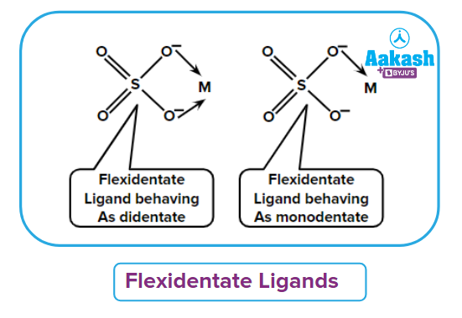
Ambidentate and flexible ligands
Some ligands can attach to the metal through different donor atoms, depending on conditions; these are called ambidentate ligands.
Ambidentate Ligands:
Nitrite (NO₂⁻): Can bond through nitrogen (nitro) or oxygen (nitrito).
Thiocyanate (SCN⁻): Can coordinate via sulfur (thiocyanato) or nitrogen (isothiocyanato).
This leads to linkage isomerism, where two complexes have identical compositions but differ in which atom of the ligand is bonded to the metal.
Flexible Ligands:
Ligands with multiple potential donor sites (e.g., amino acids, polypyridines) may change their bonding modes depending on the metal ion’s size and electronic configuration.

Slide 5
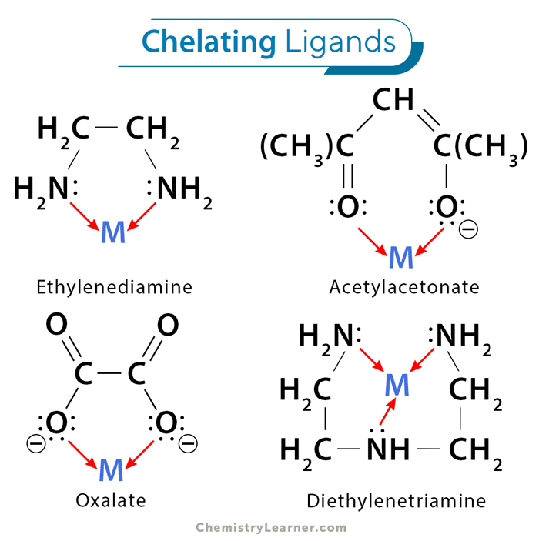
Chelation and the chelate effect
Chelation occurs when a multidentate ligand binds to a metal ion through two or more donor atoms, forming a ring structure that includes the metal ion.
Chelate Effect Explanation:
Thermodynamic basis: Formation of a chelate complex is entropically favored because one multidentate ligand replaces multiple monodentate ligands, increasing disorder.
Kinetic stability: Chelate rings are less likely to dissociate due to multiple bonds.
Biological example: Hemoglobin contains the porphyrin ring, a natural chelating ligand binding Fe²⁺.
Chelation is crucial in analytical chemistry, medicine, and environmental chemistry for metal ion sequestration and detoxification.

Slide 6
Ligand field and electronic effects
The electronic properties of ligands significantly influence the color, magnetism, and stability of complexes.
Ligand Field Theory (LFT):
Ligands interact with metal d-orbitals, splitting them into different energy levels.
The magnitude of splitting depends on the ligand’s field strength, described by the spectrochemical series.
Strong field ligands (like CN⁻, CO) cause large splitting, leading to low-spin complexes.
Weak field ligands (like H₂O, Cl⁻) cause small splitting, resulting in high-spin configurations.
Ligand field effects govern the reactivity, geometry, and even biological function of metal complexes.

Slide 7
Influence of ligands on geometry and stability
The steric and electronic properties of ligands dictate the overall shape and stability of coordination compounds.
Geometric influence:
Monodentate ligands can lead to various geometries (octahedral, tetrahedral, square planar).
Bulky ligands may cause distortions or force low coordination numbers due to steric hindrance.
Stability influence:
Polydentate ligands form more stable complexes than monodentate ones due to the chelate effect.
Electron-donating ligands strengthen metal–ligand bonds, while electron-withdrawing ones weaken them.
Ligand substitution and exchange rates depend strongly on the ligand’s donor strength and the metal’s oxidation state.

Slide 8
Summary
Ligands are electron-pair donors that form coordinate covalent bonds with metal ions.
They can be mono-, bi-, or polydentate, depending on the number of bonding atoms.
Ambidentate ligands can bond through different atoms, giving rise to linkage isomerism.
Chelation greatly enhances complex stability through entropic and enthalpic advantages.
Ligand field theory explains how ligands affect the metal’s electronic structure and properties.
The choice and nature of ligands determine the geometry, color, reactivity, and function of coordination compounds.
Ligands play a crucial role in biological systems, catalysis, and industrial chemistry, making them indispensable in modern science.
Ligands form the structural and functional backbone of coordination chemistry. By controlling the nature of the metal–ligand interaction, chemists can design complexes with tailored properties for medicine, catalysis, and materials science—illustrating the profound importance of ligand chemistry in understanding and shaping the molecular world.

Slide 9
Thank you for attention!

